Slide 1
The Relational Data Model

Slide 2
Relational Data Model
The relational data model is a logical data model that organizes data into relations (tables) consisting of rows (tuples) and columns (attributes).
Relationships between tables are typically established using primary keys and foreign keys.

Slide 3
Domain
A domain is the original sets of atomic values used to model data. By atomic value, we mean that each value in the domain is indivisible as far as the relational model is concerned.
For example:
The domain of Marital Status has a set of possibilities:
Married, Single, Divorced.
The domain of Shift has the set of all possible days:
{Mon, Tue, Wed…}.
The domain of Salary is the set of all floating-point numbers greater than 0 and less than 200,000.
The domain of First Name is the set of character strings that represents names of people.

Slide 4
Relation
A relation, also known as a table or file, is a subset of the Cartesian product of a list of domains characterized by a name.
And within a table, each row represents a group of related data values.
A row, or record, is also known as a tuple.
The columns in a table is a field and is also referred to as an attribute.
Degree
The degree is the number of attributes in a table.
The steps below outline the logic between a relation and its domains.
1. Given n domains are denoted by D1, D2, … Dn
2. And r is a relation defined on these domains
3. Then r ⊆ D1×D2×…×Dn

Slide 5
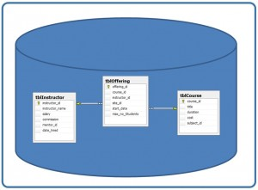
Database
A database is composed of multiple tables and each table holds the data.
Column
The principal storage units are called columns or fields or attributes. These house the basic components of data into which your content can be broken down.

Slide 6
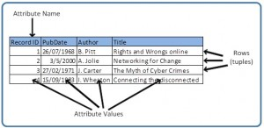
Records
Records contain fields that are related, such as a customer or an employee. As noted earlier, a tuple is another term used for record.
Records and fields form the basis of all databases. A simple table gives us the clearest picture of how records and fields work together in a database storage project.

Slide 7
Properties of a Table
A table has a name that is distinct from all other tables in the database.
There are no duplicate rows; each row is distinct.
Entries in columns are atomic. The table does not contain repeating groups or multivalued attributes.
Entries from columns are from the same domain based on their data type including:
number (numeric, integer, float, smallint,…)
character (string)
date
logical (true or false)
Operations combining different data types are disallowed.
Each attribute has a distinct name.
The sequence of columns is insignificant.
The sequence of rows is insignificant.

